Slide 1
MA3077 Operational Research Lecture 4 – Feasibility and duality in linear programming
Dr Marco Fasondini

Slide 2
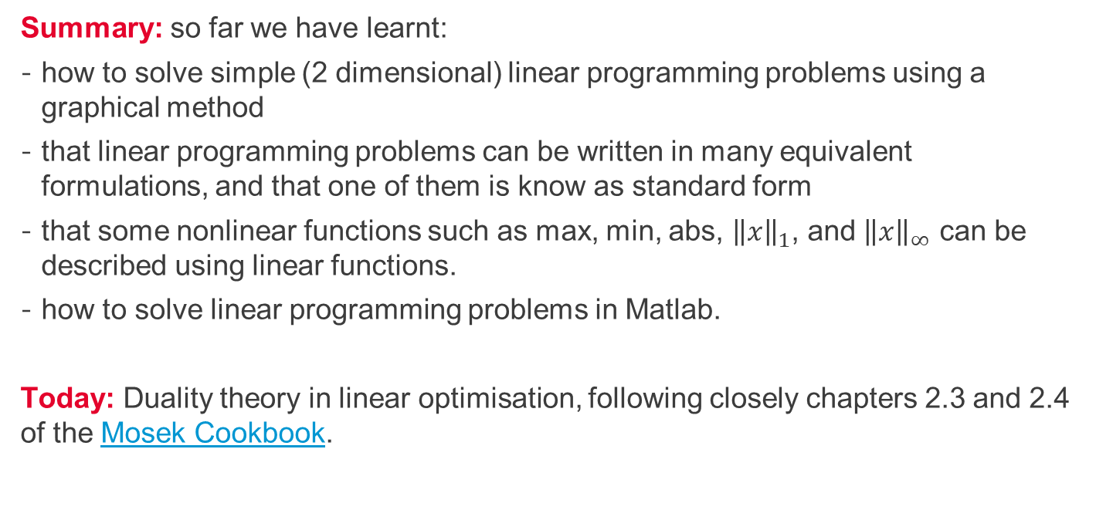
Recapitulation and lecture outline
Summary: so far we have learnt:
how to solve simple (2 dimensional) linear programming problems using a graphical method
that linear programming problems can be written in many equivalent formulations, and that one of them is know as standard form
that some nonlinear functions such as max, min, abs, ${\left\|x\right\|}_{1}$, and ${\left\|x\right\|}_{∞}$ can be described using linear functions.
how to solve linear programming problems in Matlab.
Today: Duality theory in linear optimisation, following closely chapters 2.3 and 2.4 of the Mosek Cookbook.

Slide 3
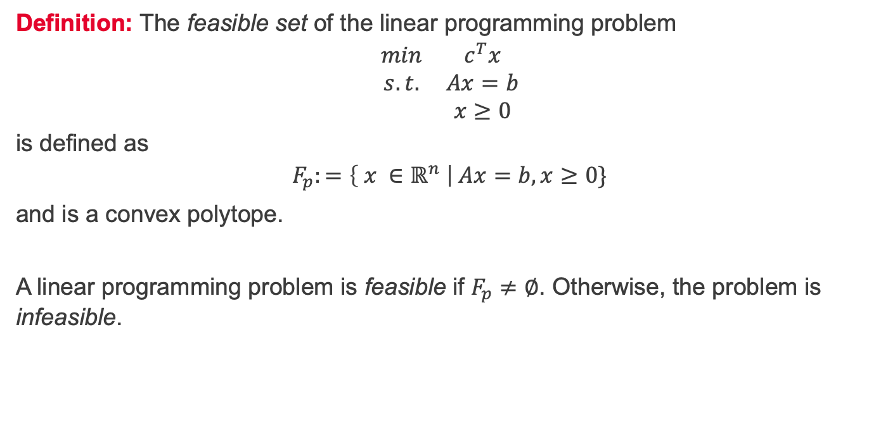
Feasible set
Definition: The feasible set of the linear programming problem
$$\begin{matrix}min & c^{T}x \\ s.t. & Ax=b \\ & x≥0\end{matrix}$$
is defined as
$$F_{p}:=\left\{ x ∈ℝ^{n} \right| Ax=b, x≥0\}$$
and is a convex polytope.
A linear programming problem is feasible if $F_{p}≠∅$. Otherwise, the problem is infeasible.

Slide 4
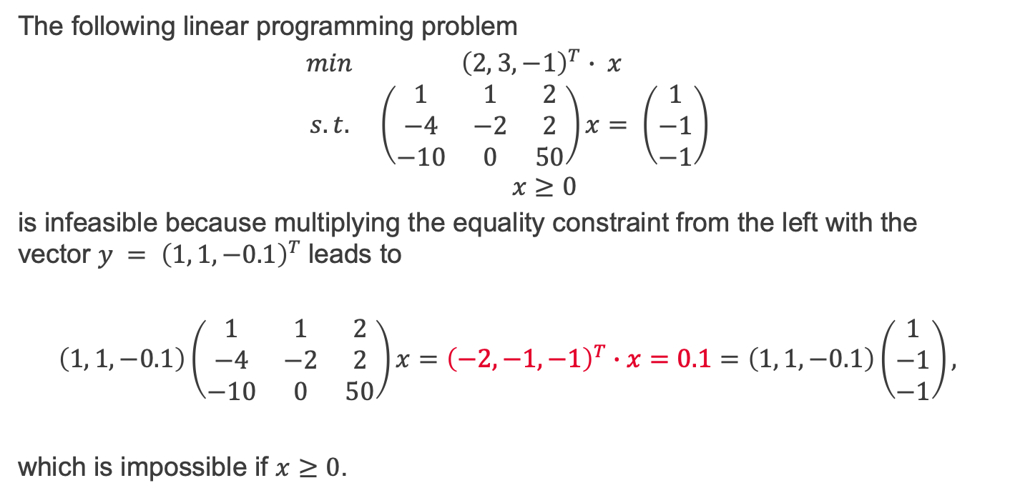
Example of an infeasible problem
The following linear programming problem
$$\begin{matrix}min & {\left(2, 3, −1\right)}^{T}∙ x \\ s.t. & \left(\begin{matrix}1 & 1 & 2 \\ −4 & −2 & 2 \\ −10 & 0 & 50\end{matrix}\right)x= \left(\begin{matrix}1 \\ −1 \\ −1\end{matrix}\right) \\ & x≥0\end{matrix}$$
is infeasible because multiplying the equality constraint from the left with the vector $y = {\left(1, 1, −0.1\right)}^{T}$leads to
$$\left(1, 1, −0.1\right)\left(\begin{matrix}1 & 1 & 2 \\ −4 & −2 & 2 \\ −10 & 0 & 50\end{matrix}\right)x={\left(−2, −1, −1\right)}^{T}∙x=0.1=\left(1, 1, −0.1\right)\left(\begin{matrix}1 \\ −1 \\ −1\end{matrix}\right),$$
which is impossible if $x≥0$.

Slide 5
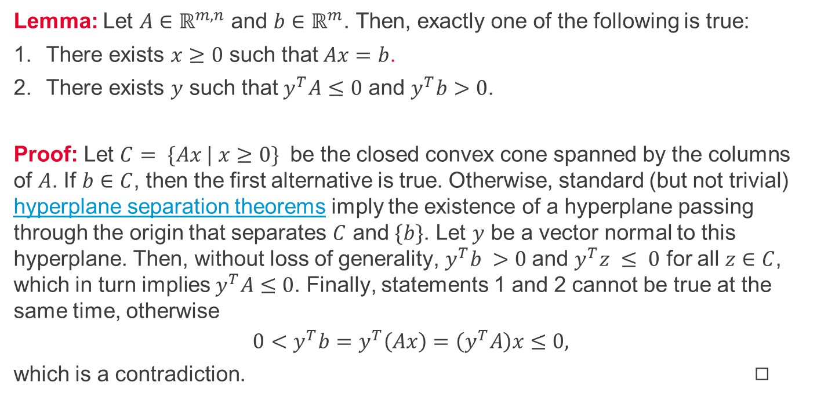
Farkas' lemma
Lemma: Let $A∈ℝ^{m,n}$ and $b∈ℝ^{m}$. Then, exactly one of the following is true:
There exists $x≥0$ such that $Ax=b$.
There exists $y$ such that $y^{T}A≤0$ and $y^{T}b>0$.
Proof: Let $C= \{Ax | x≥0\}$ be the closed convex cone spanned by the columns of $A$. If $b∈C$, then the first alternative is true. Otherwise, standard (but not trivial) hyperplane separation theorems imply the existence of a hyperplane passing through the origin that separates $C$ and $\{b\}$. Let $y$ be a vector normal to this hyperplane. Then, without loss of generality, $y^{T}b >0$and $y^{T}z ≤ 0$ for all $z∈C$, which in turn implies $y^{T}A≤0$. Finally, statements 1 and 2 cannot be true at the same time, otherwise
$$0<y^{T}b=y^{T}\left(Ax\right)=\left(y^{T}A\right)x≤0,$$
which is a contradiction. ◻︎

Slide 6
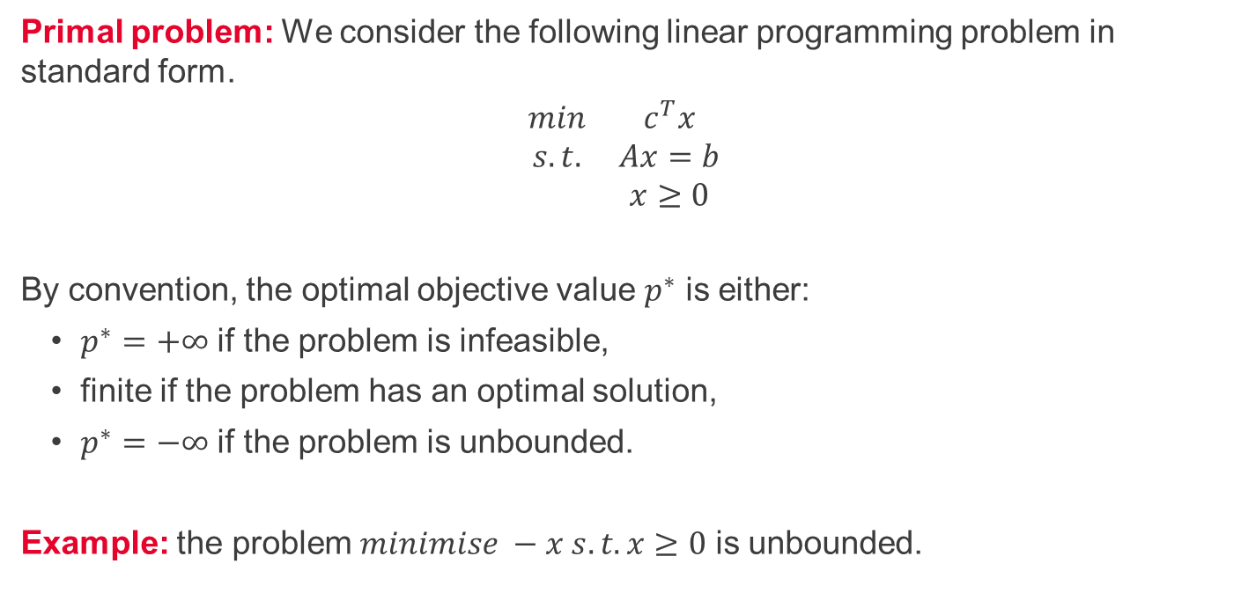
Duality – primal problem
Primal problem: We consider the following linear programming problem in standard form.
$$\begin{matrix}min & c^{T}x \\ s.t. & Ax=b \\ & x≥0\end{matrix}$$
By convention, the optimal objective value $p^{∗}$ is either:
$p^{∗}=+∞$ if the problem is infeasible,
finite if the problem has an optimal solution,
$p^{∗}=−∞$ if the problem is unbounded.
Example: the problem $minimise −x s.t. x≥0$ is unbounded.

Slide 7
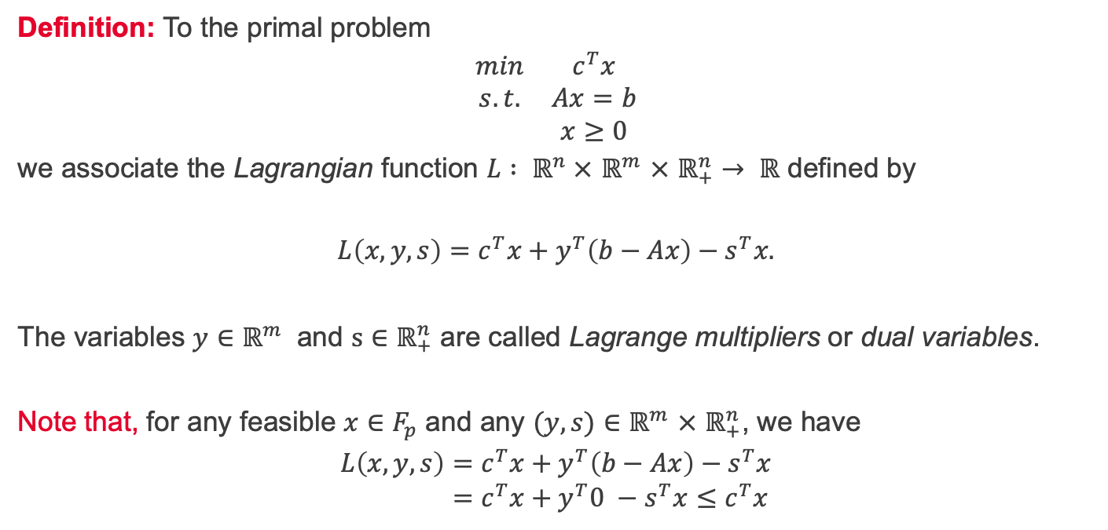
Duality – Lagrange function
Definition: To the primal problem
$$\begin{matrix}min & c^{T}x \\ s.t. & Ax=b \\ & x≥0\end{matrix}$$
we associate the Lagrangian function $L : ℝ^{n} ×$ $ℝ^{m}$ $×$ $ℝ_{+}^{n}→ ℝ$ defined by
$$L\left(x,y,s\right)=c^{T}x+y^{T}\left(b−Ax\right)−s^{T}x.$$
The variables $y∈ℝ^{m}$ and $s∈ℝ_{+}^{n}$ are called Lagrange multipliers or dual variables.
Note that, for any feasible $x∈F_{p}$ and any $(y,s)∈ℝ^{m}$ $×$ $ℝ_{+}^{n}$, we have
$$L\left(x,y,s\right)=c^{T}x+y^{T}\left(b−Ax\right)−s^{T}x \\ =c^{T}x+y^{T}0 −s^{T}x≤c^{T}x$$

Slide 8
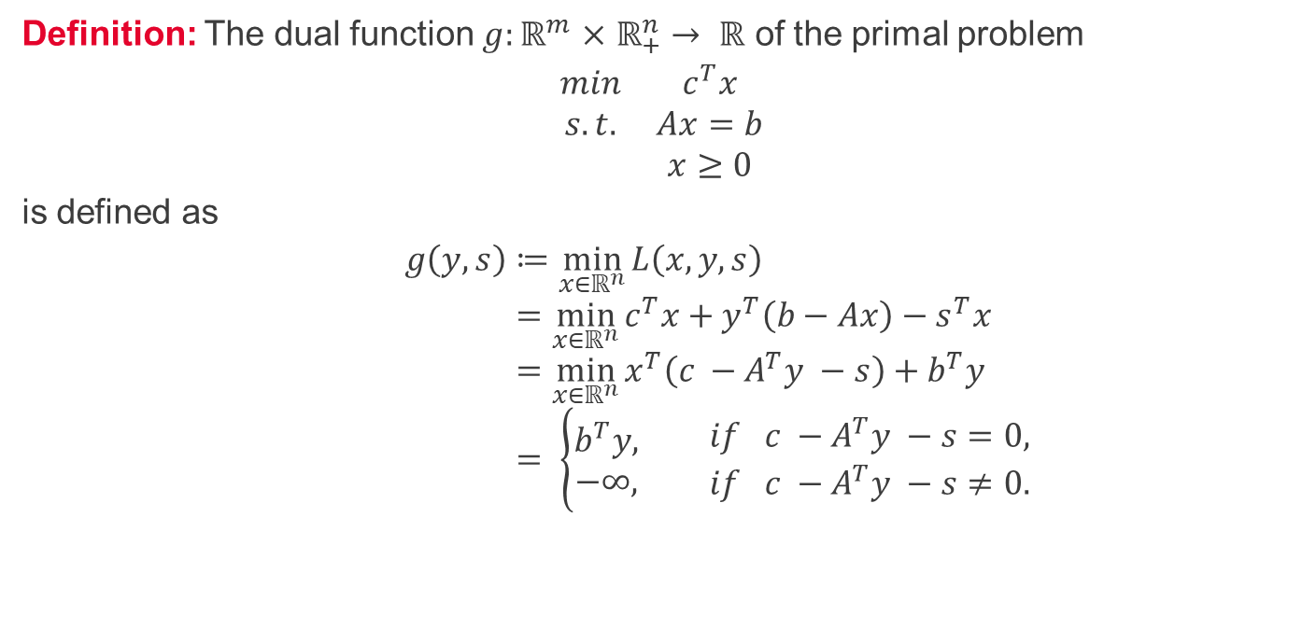
Duality – dual function
Definition: The dual function $g:ℝ^{m}$ $×$ $ℝ_{+}^{n}→ ℝ$ of the primal problem
$$\begin{matrix}min & c^{T}x \\ s.t. & Ax=b \\ & x≥0\end{matrix}$$
is defined as
$$g\left(y,s\right)≔\min_{x∈ℝ^{n}}{L\left(x,y,s\right)} \\ =\min_{x∈ℝ^{n}}{c^{T}x+y^{T}\left(b−Ax\right)−s^{T}x} \\ =\min_{x∈ℝ^{n}}{x^{T}\left(c −A^{T}y −s\right)+b^{T}y} \\ = \left\{\begin{aligned}b^{T}y, \\ −∞,\end{aligned} \begin{matrix}if c −A^{T}y −s=0, \\ if c −A^{T}y −s≠0.\end{matrix}\right.$$

Slide 9
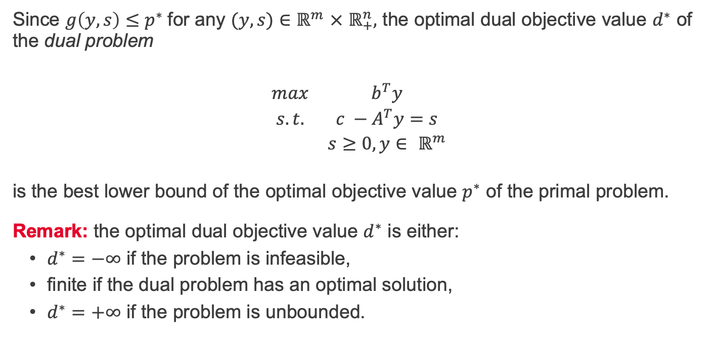
Duality – dual problem
Since $g\left(y,s\right)≤p^{∗}$for any $(y,s)∈$ $ℝ^{m}$ $×$ $ℝ_{+}^{n},$ the optimal dual objective value $d^{∗}$ of the dual problem
$$\begin{matrix}max & b^{T}y \\ s.t. & c −A^{T}y=s \\ & s≥0, y∈ ℝ^{m}\end{matrix}$$
is the best lower bound of the optimal objective value $p^{∗}$ of the primal problem. Remark: the optimal dual objective value $d^{∗}$ is either:
$d^{∗}=−∞$ if the problem is infeasible,
finite if the dual problem has an optimal solution,
$d^{∗}=+∞$ if the problem is unbounded.

Slide 10
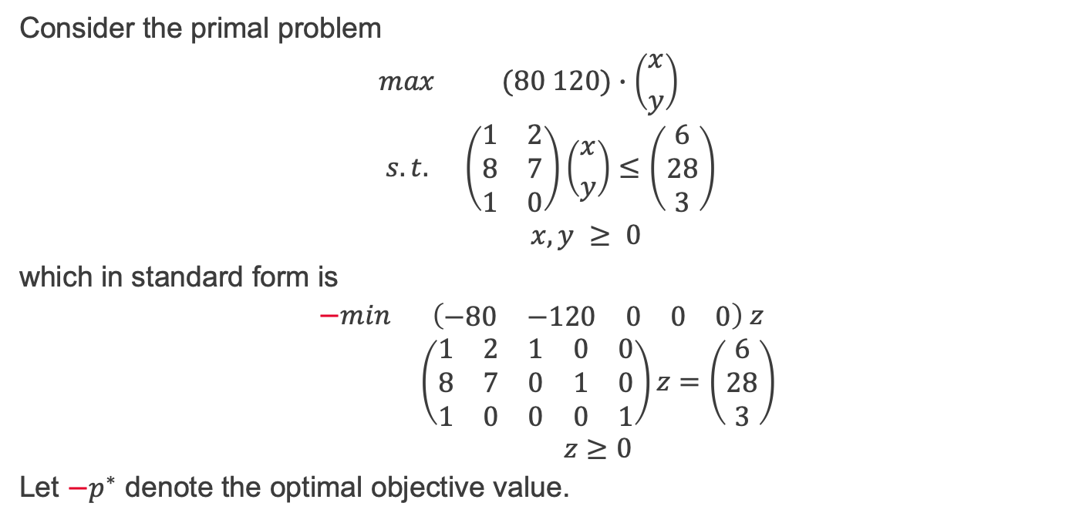
Duality – example 1/2
Consider the primal problem
$$\begin{matrix}max & (80 120)∙\left({x \atop y}\right) \\ s.t. & \left(\begin{matrix}1 & 2 \\ 8 & 7 \\ 1 & 0\end{matrix}\right)\left({x \atop y}\right)≤\left(\begin{matrix}6 \\ 28 \\ 3\end{matrix}\right) \\ & x,y ≥ 0 \end{matrix}$$
which in standard form is
$$\begin{matrix}−min & \left(\begin{matrix}−80 & −120 & 0 & 0 & 0\end{matrix}\right) z \\ & \left(\begin{matrix}1 & 2 & 1 & 0 & 0 \\ 8 & 7 & 0 & 1 & 0 \\ 1 & 0 & 0 & 0 & 1\end{matrix}\right)z=\left(\begin{matrix}6 \\ 28 \\ 3\end{matrix}\right) \\ & z≥0\end{matrix}$$
Let $−p^{∗}$ denote the optimal objective value.

Slide 11
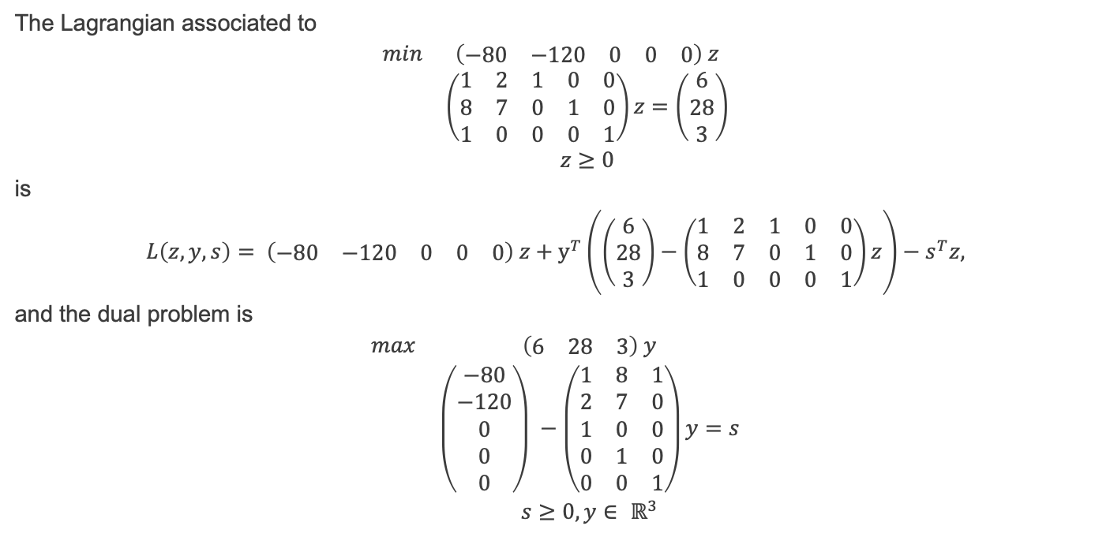
Duality – example 2/2
The Lagrangian associated to
$$\begin{matrix}min & \left(\begin{matrix}−80 & −120 & 0 & 0 & 0\end{matrix}\right) z \\ & \left(\begin{matrix}1 & 2 & 1 & 0 & 0 \\ 8 & 7 & 0 & 1 & 0 \\ 1 & 0 & 0 & 0 & 1\end{matrix}\right)z=\left(\begin{matrix}6 \\ 28 \\ 3\end{matrix}\right) \\ & z≥0\end{matrix}$$
is
$$L\left(z,y,s\right)= \left(\begin{matrix}−80 & −120 & 0 & 0 & 0\end{matrix}\right) z+y^{T}\left(\left(\begin{matrix}6 \\ 28 \\ 3\end{matrix}\right)−\left(\begin{matrix}1 & 2 & 1 & 0 & 0 \\ 8 & 7 & 0 & 1 & 0 \\ 1 & 0 & 0 & 0 & 1\end{matrix}\right)z\right)−s^{T}z,$$
and the dual problem is
$$\begin{matrix}max & \left(\begin{matrix}6 & 28 & 3\end{matrix}\right) y \\ & \left(\begin{matrix}−80 \\ −120 \\ 0 \\ 0 \\ 0\end{matrix}\right) −\left(\begin{matrix}1 & 8 & 1 \\ 2 & 7 & 0 \\ 1 & 0 & 0 \\ 0 & 1 & 0 \\ 0 & 0 & 1\end{matrix}\right)y=s \\ & s≥0,y∈ ℝ^{3}\end{matrix}$$

